Slide 1
Outline
The background.
Introduction of methods.
Results.
Summary

Slide 2
ethnicity is relative
An ethnic group is a category of people who identify with each other based on similarities such as common ancestry, language, history, society, culture or nation.
Ethnicity is not a accurate scientific term, but is based on social construct and self-identity.
As a result, this is no way to truly define or identify the “true ethnicity” based on biological information. The only thing we can do is compare the data to find the biological closest population.
Thus, our goal is not aim to “distinguish” the ethnicity, but locate the patient to closest ethnicity group in our references.

Slide 3
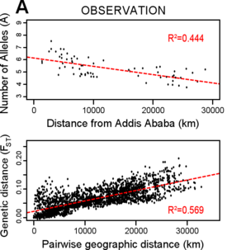
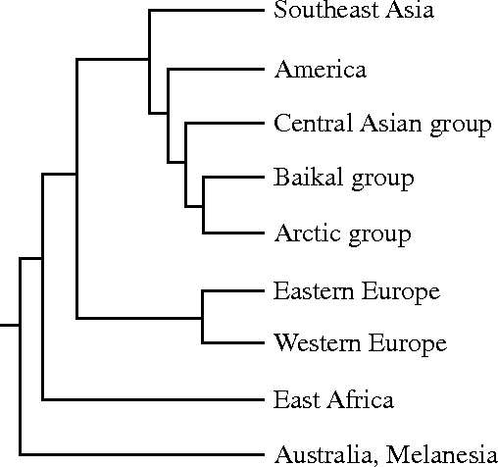
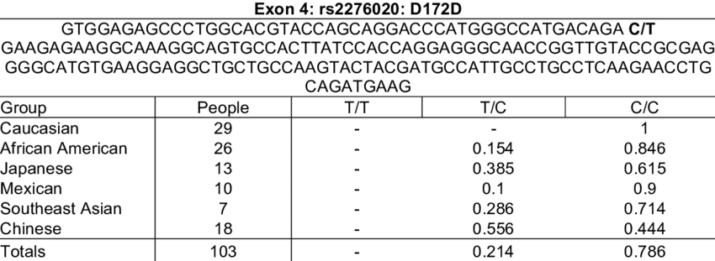
Build Proper model for study
To locate the patient on references, building a model to map our data is necessary, which requires the understanding of structure and relationships between the populations.
There are three candidates of the model:
phylogenetic
Continuity
Categorical (multivariable)
e.g.

Slide 4
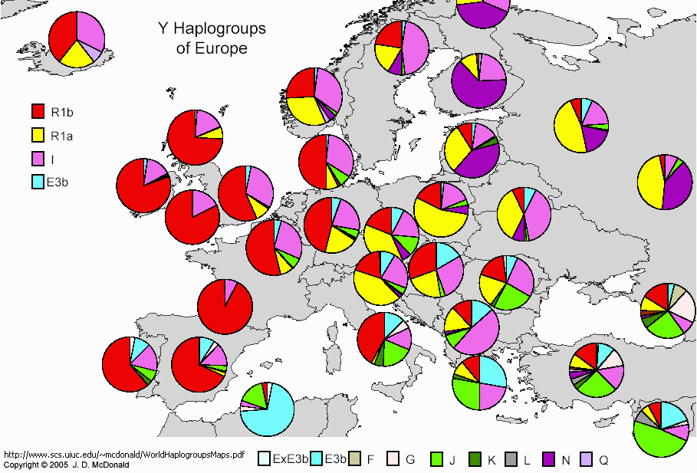
Phylogenetic model and why it is not fit
Phylogenetic model builds all groups on a phylogenetic tree, thus we can locating the patient step by step by finding his neighbors and enclosed clade. It can provides more information and more reliable. It is actual the most ideal model.
However, Phylogenetic model requires all groups to be mono-phyletic (or most mono-phyletic). However, it is not true, especially for European groups.
The left graph shows that all European countries are mixture of some true mono-phyletic groups

Slide 5
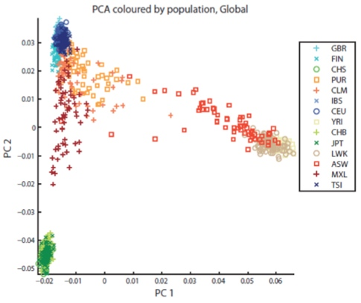
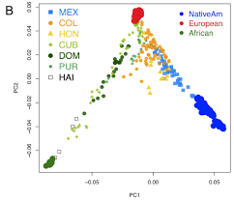
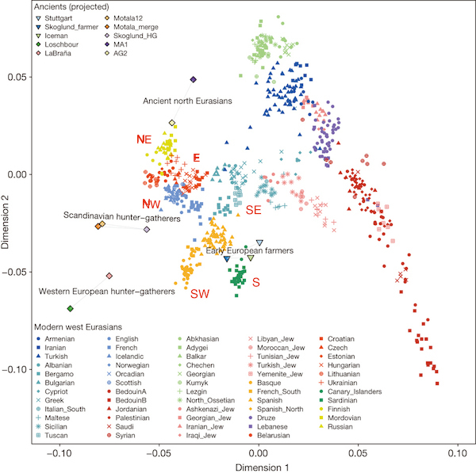
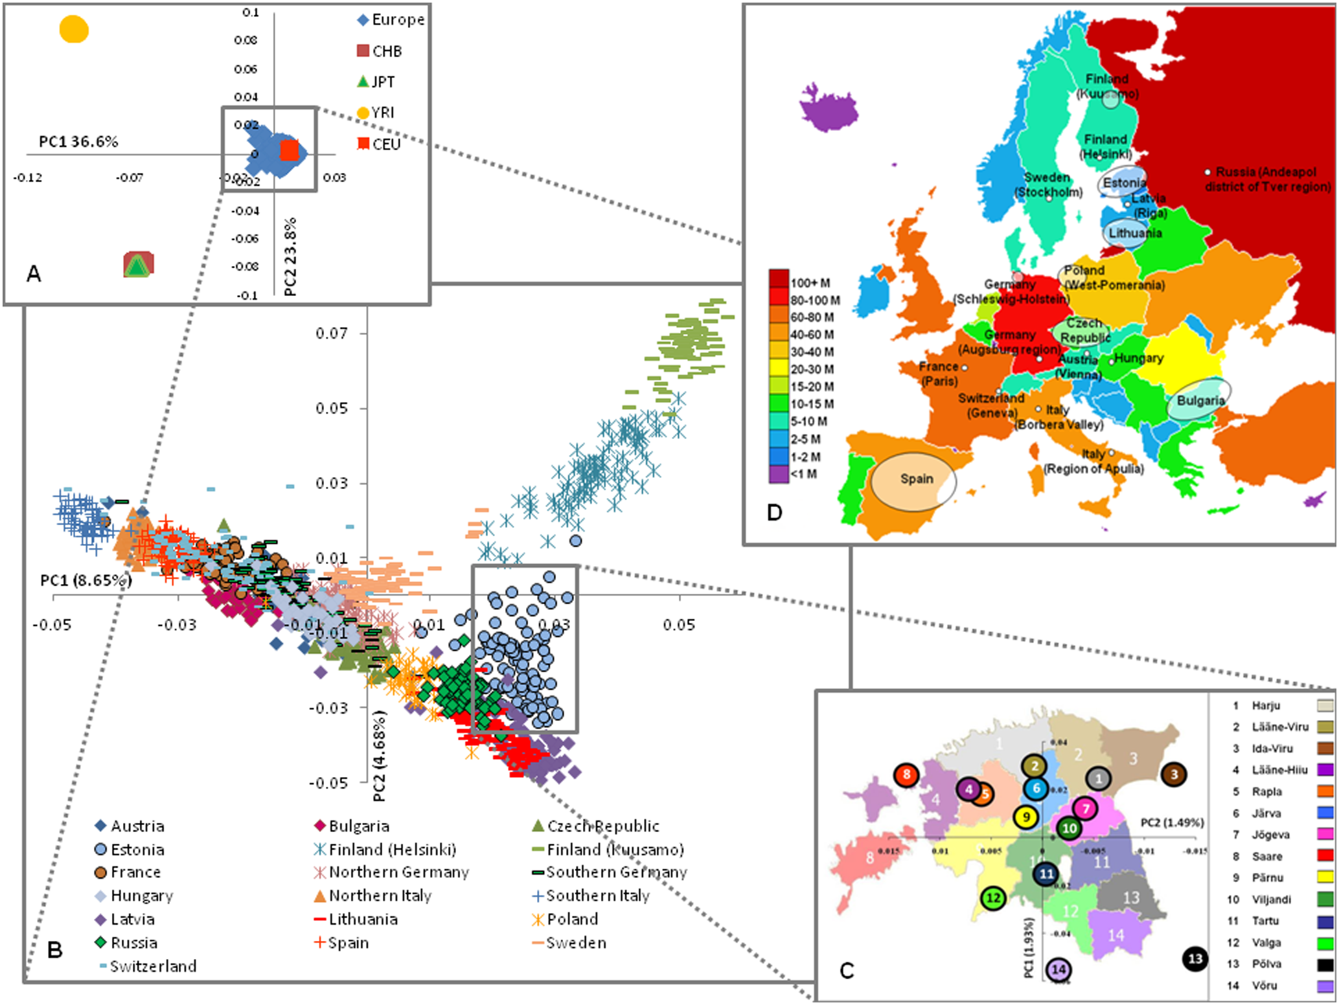
Phylogenetic model and why it is not fit
Also, it is impossible to find a clear, accurate tree relationships among European populations.
When plotting super-populations, the distribution is always similar and thus the relationship is clear.
However, when plotting European population, different study gives different structures.
Thus European populations’ relationships is very confusing.

Slide 6
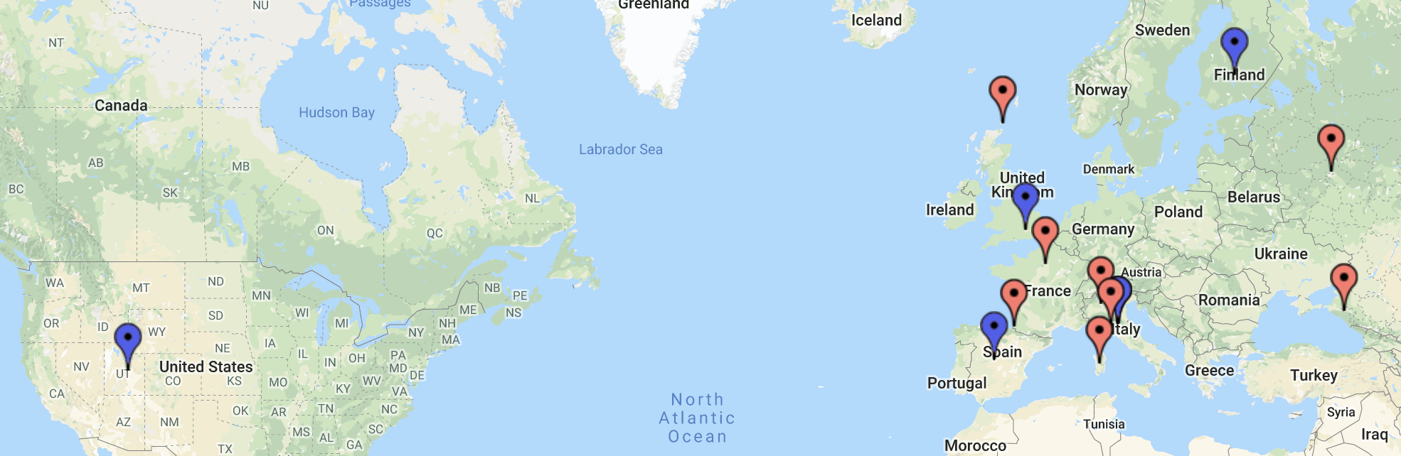
Continuity model and why it’s also not fit
Continuity model associates ethnicity groups with some simple continuity variables. (e.g geographical distance, or frequency of several informative marks…)
The informative marks is very hard to use: 1. different publication gives different informative marks based on their references and proposes different structure of ethnicity groups 2. this method will not work well with highly mixed people.
Geographical distance also does not work because there are many isolate groups hard to determine distance (e.g CEU, British, Sardinian and Orcadian)
The referenced ethnic groups we have
are very separated and discontinue

Slide 7
Categorical model is the only choice
Categorical model is a compromise when we cannot figure out the inner connections and relationships among groups. Thus, we treat all groups equally and parallel.
Considering about the massive SNPs data we have, multivariable categorical model is not a bad choice since it can take advantage of all SNPs we have instead of just using a part of informative marks, the confidence will be higher.

Slide 8
Two challenges of this model
1. resolution vs confidence
When the information is limited, this is always trade-off between resolution and confidence.
The higher the resolution, the more data is required to have same confidence.
Thus, when data is limited, increase of resolution will decrease the confidence.

Slide 9
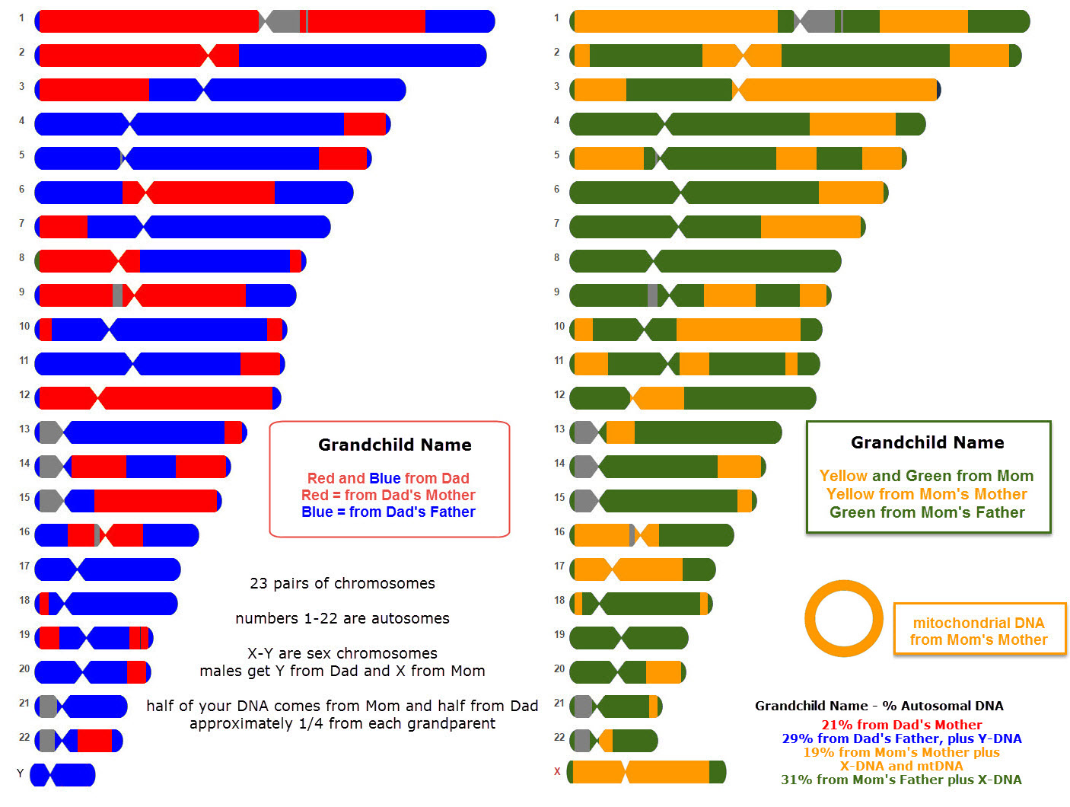
1. resolution vs confidence
How is affect our study ?
This is a real case of chromosomes after recombination, the ethnicities of different regions of same chromosome can be different !!!
This requires us to obtain higher resolution thus might decrease confidence.

Slide 10
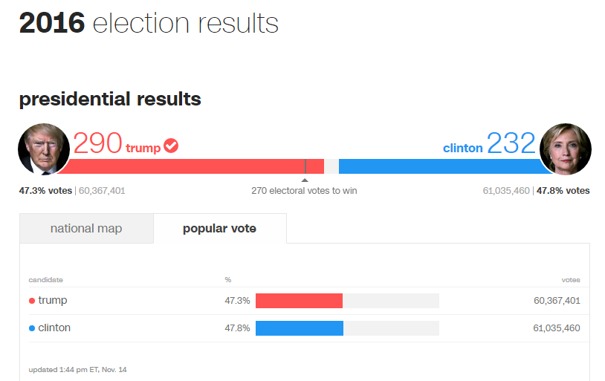
2. Informative vs Overall
When determining the closest group, the result can be determined by two factors.
Frequency at SNPs.
Overall match coverage.
For example: there are two groups:
Group A: {-AAAA-, -ATAA-,-AAAA-,-AAAT-, -AAAA-,-AAAT-};
Group B: {-TAAA-, -TTAA-,-AATA-,-TATA-, -AAAA-,-TAAT-}
the patient is –AATA-
Based on frequency, Group B is the closer group because no T observed at marked site in group A.
Based on coverage, Group A is the closer group since 4 sites of patients are similar to group A, while there is only two sites in group B
As you can see, two factors can conflict when informative marks conflict with overall results.
Just like election, trump has more electoral
while Clinton has more popular vote.
Clinton has frequency win, but lose on state coverage.
This scenario happens commonly in highly mixture tie situation.

Slide 11
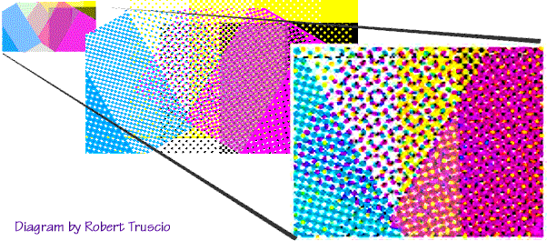
Solutions for these challenges
Resolution vs Confidence.
Analyze in different scales:
Bigger scale: has lower resolution but higher confidence.
Smaller scale: has higher resolution but lower confidence.
The ethnicity confirmed in multiply scales is more likely to be true.
Informative vs Overall.
Applying different methods.
Two methods used (PCA and Multi-variable Binomial Conditional Probability)

Slide 12
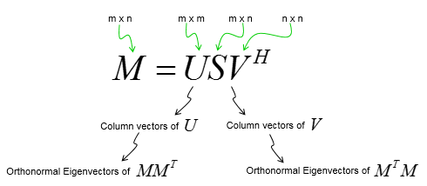
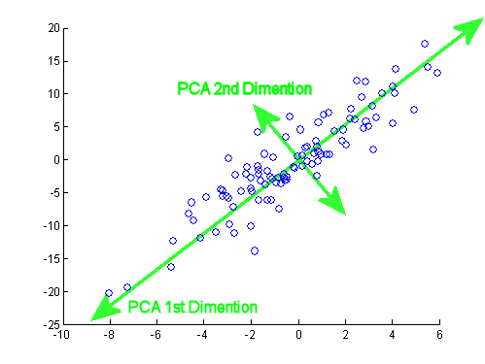
Two major methods used based on the model
Principal components analysis (PCA)
PCA is used to reduce dimension of the dataset by transforming data to the orthogonal vector space.
Commonly used in research to visualize dataset. However, not very accurate and easily have interference.
PCA is very sensitive on finding most variate components (hence informative mark here), so it focuses on frequencies on informative marks.
General equation of PCA
Simple example of PCA on two dimension space

Slide 13
Multi-variable Binomial Conditional Probability.
Bayes' theorem:
Conditional probability: the likelihood of event A occurring given that B is true
Can be used to calculate the probability of being one ethnicity giving a known genotype.
Score determination at each SNP.
when observed m minor alleles in n sample sizes:
Score determination at multiply SNPs:
Multi-variable Binomial model:
Compared with PCA, This methods focuses more on general coverage.

Slide 14
Building Reference
Two sets of datasets are used in this study:
Standford’s The Human Genome Diversity Project (HGDP)
1000 samples Include 63 populations and 160 Europeans in 8 European populations. ('Adygei','French','North_Italian','Orcadian','Russian','Sardinian', 'Tuscan’)
1000 Genome project.
Over 1000 samples 26 populations and 500 Europeans in 5 populations. ('CEU', 'GBR','IBS', 'TSI', 'FIN')
Combination of two datasets
Common SNPs are selected and import into one dataset.
All SNPs with minor allele frequency < 0.05 were filtered.
(only for PCA) reference were pruned with LD R^2 >= 0.5 at 1000 window.
Geographic position of each European
population referenced.
Blue: 1000 Genome
Red: HGDP
Total 12 populations,
one shared population (TSI or Tuscan)

Slide 15
Error in combined reference
PCA is very sensitive on catching up “informative” SNPs. However, these SNPs can be informative on ethnicity, but also can be informative on artificial platform…
By 1000GP
HG00250_1000GP (black)
The graph on the left clearly shows the errors in different platforms severely affects PCA results.
Samples from 1000GP and HGDP clusters at different regions.
Tuscan & TSI are shared population, but they separates far from each other.
Same people (HG00250) from different platforms (our whole genome sequencing and 1000GP) very far from each other.
Although there is only 0.14% SNPs are different between the results of HG00250 from different platforms, In the direction matrix (the U in the PCA equation), those 0.14% SNPs occupies 22% of total variance.
HG00250_WGS (grey)
Tuscan(TSI)
By HGDP

Slide 16
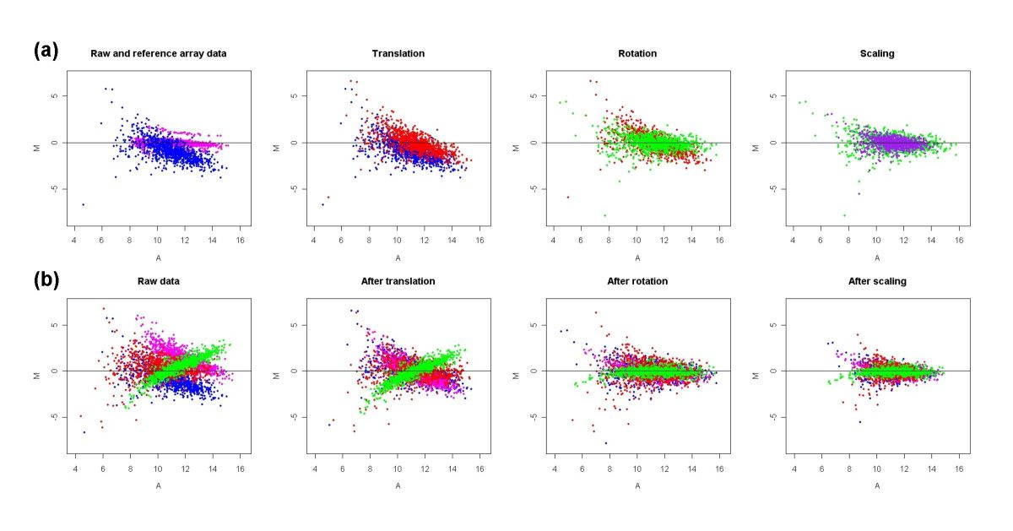
Correction on combined reference
There is a shared population (Tuscan & TSI) in both platforms.
The F-index shows only 0.0013 difference between them;
T-test on each SNP shows less than 10% SNPs are over 95% confidence level.
These results show that we can treat them as a same population.
By using the results of this population from different platform, we can use those data to build coordinate system to correct data. (Procrustes Analysis)
Example of Procrustes correction
Note: This correction is only used for PCA, not Binomial Conditional Probability

Slide 17
Additional correction used to reduce error and increase resolution
The PCA calculation and Eigenvector projection steps were manually split and PCA used to project samples are furbished before projection (plotting), the plotted samples were excluded and only reference samples were used to determined PCA.
All samples within a population were equalized based on MAF in PCA determination, thus to reduce the intra-population variance and can reduce interference to increase resolution.
Based on these approaches, PCA only captures the variance between variance between different populations within references.

Slide 18
Results after correction
CHR19
Full Genome
HG00250(black and grey)
Tuscan and TSI
The correction is clearly very successful:
1. The distribution of two platforms no longer separate
2. The results of same person (HG00250) from different platforms almost overlap and locate in GBR (the population reported).
3. The shared population (Tuscan and TSI) overlaps.
4. By looking the graph of full genome, 1. Finland population close to Russian; 2. CEU, British, Orcadian and French close to each other; 3. Adygei, Basque, and Sardinian separate well; 4.North Italian close to Tuscan. These all match with common understanding of European population and many other ethnicity studies.

Slide 19
Some Basic information of LDLR (target mutated gene)
1. This gene is located at chr19:11,089,362-11,133,830 (hg38)
2. The phased block of the sample that contains this gene is chr19:9,189,309-12,793,215, which contains 395 SNPs
3. the deletion was found on first allele. (Allele #0)

Slide 20
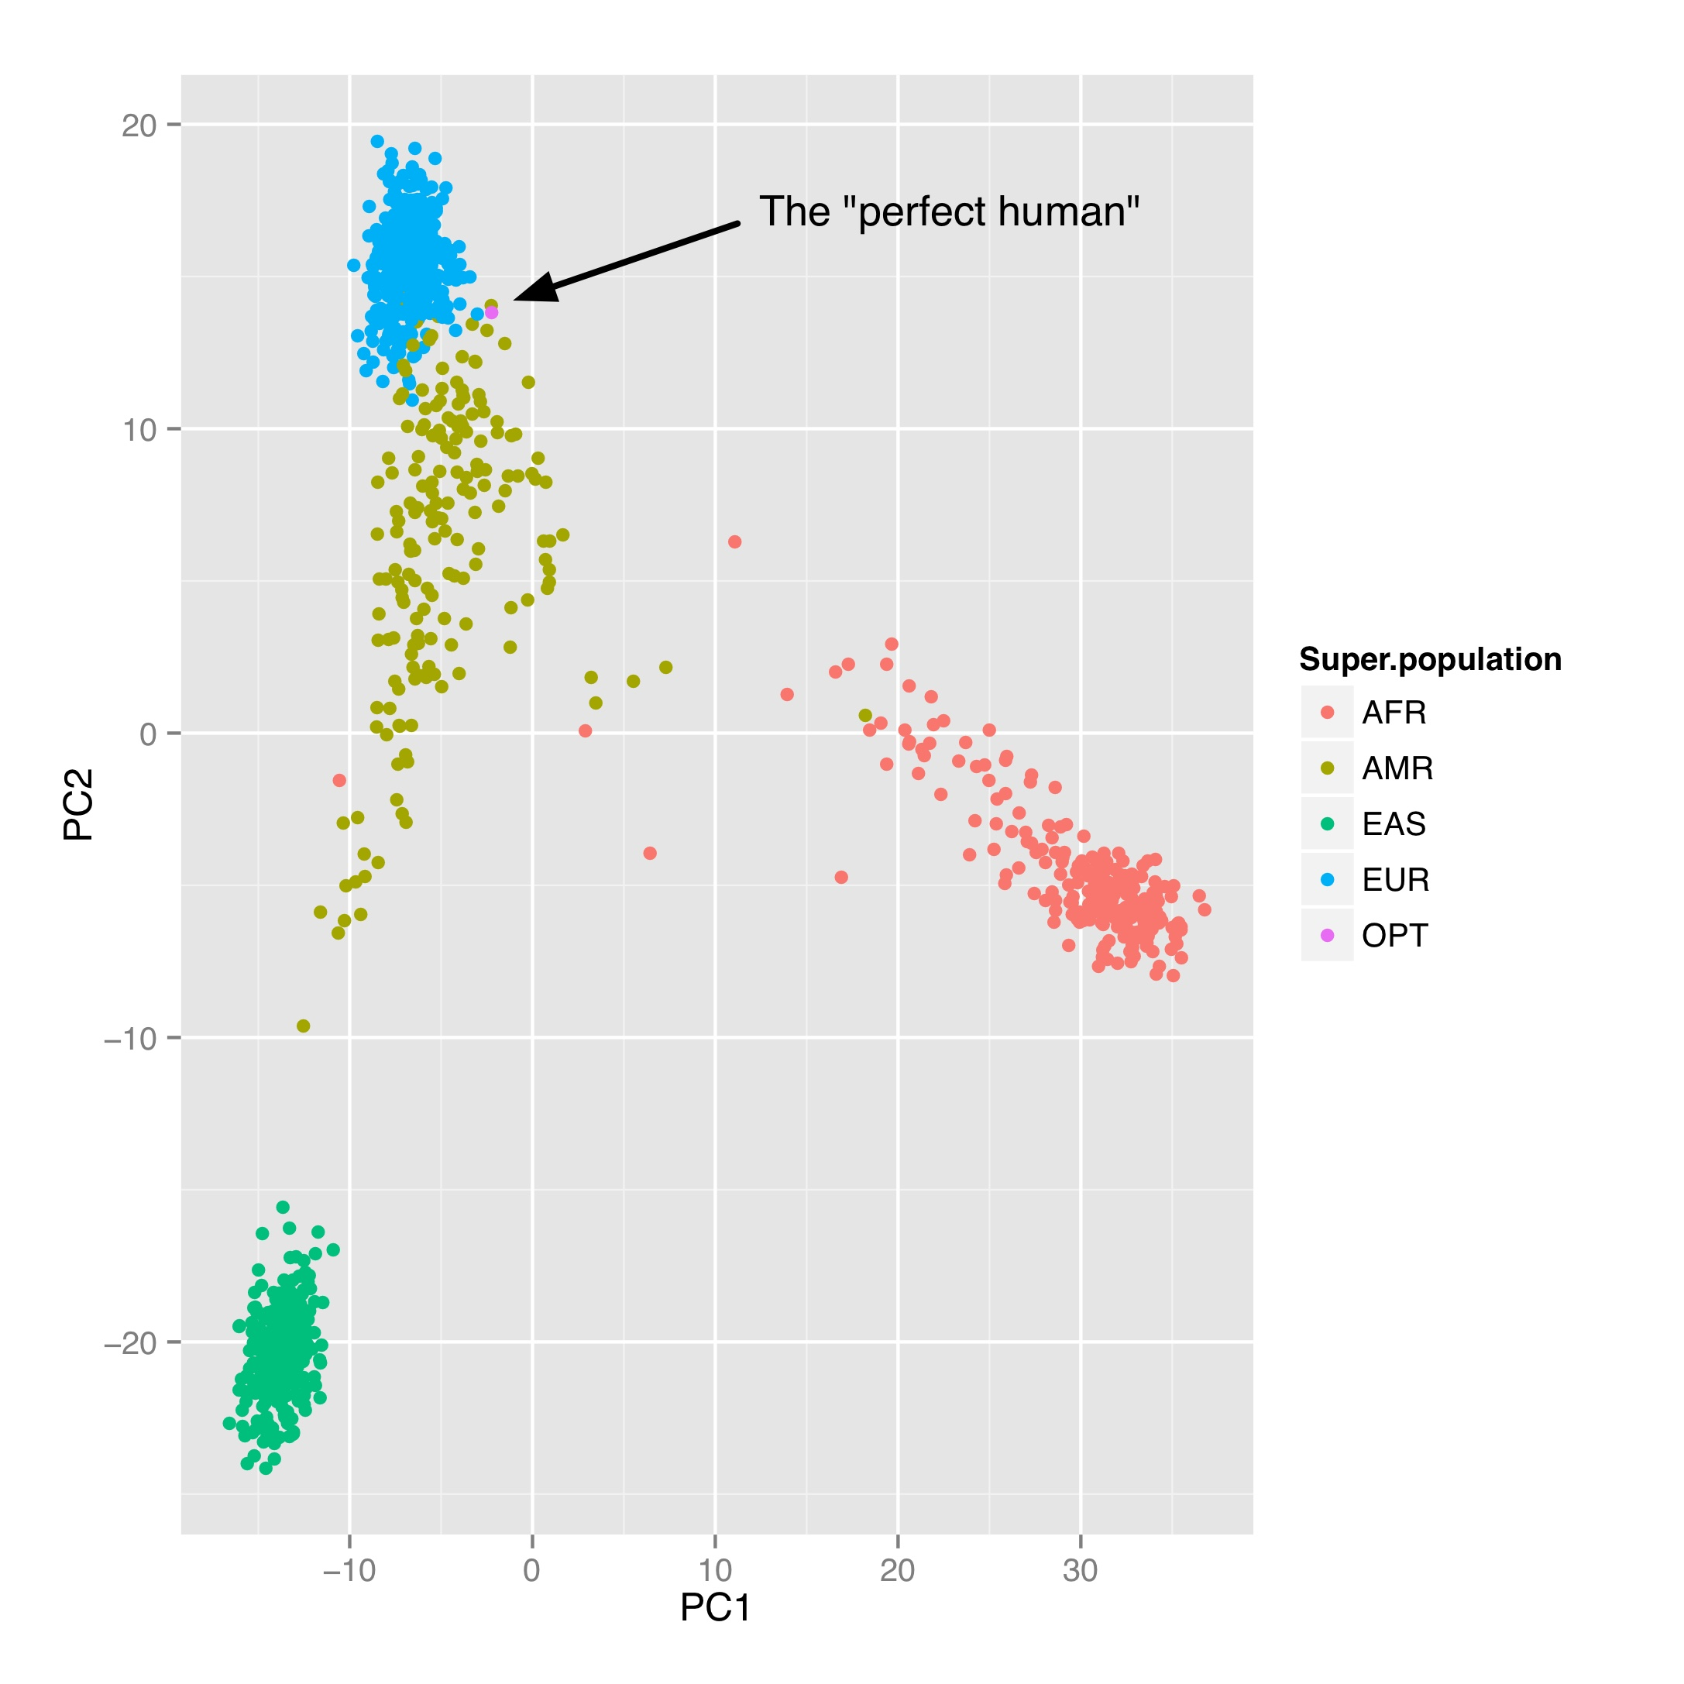
First, PCA confirms the patient is Caucasian
Results
Patient
Results
PCA graph in other studies

Slide 21
Whole genome PCA
HG00353(Finland)
HG00000 (artificial mixture
of HG00353 and HG00250)
Patient (SN31856)
HG00250(British)
The left PCA graph is the control and
shows this method is workable for both mono-ethnicity and mix
The right PCA graph shows that this patient is mostly CEU/GBR

Slide 22
Whole genome CBP, results of control samples
The left two charts give the percentage of genome in each population based on results of each chromosome
The top right is the numeric add-up of the results on the left, which is the expected percentage of artificial mix.
The bottom right is the results of artificial mix, which is experimental results of the add-up.
Comparing two results on the right, the P_{chi-square}=e-7, very significant to say those results are match.
This shows CBP can also use to identify composition of mix.

Slide 23
Whole genome CBP, result of the patient
This is the result of the patient, this chart shows that majority of his genome is close to CEU and GBR
(CEU and GBR are very close to each other based on PCA and history record), which is reasable. However, the result is still very complicate and we can find compositions of many different populations.

Slide 24
CHR19 (where LDLR locate in) PCA
1000 GP
Both after correct
HGDP +CEU(projected but used not in PCA)
Those are PCA results of chr19 for the patient, they all confirm that the majority of chr19 is CEU & GBR,
match with prior results.

Slide 25
CHR19
CBP
The left are CBP results of the patient and control sample (HG00353) at chr19, the result of HG00353 matchs with reported population(FIN).
However, the results of patient is a little confusing, because two highest score are very close to each other.
But we successfully figured out that one of the chromosome pairs is close to CEU, while another is most likely to be Russian or French.

Slide 26
Loci of CHR19 CBP
The percentage of loci closest to each population at different of windows (at P<0.001 confidence level).
At all windows, the CEU is the dominate composition and Russia and are also find in all windows.
Note: 1. window means the number of SNP use to determine closest population.
2. loci cannot be determined are excluded from results, so this may not be accurate percentage of CHR19

Slide 27
LDLR
the possible combination of population at their scores at each window size
Window at 3000 | 'Adygei_CEU' | 17.74636178 | 'CEU_Russian' | 16.46965627 | 'CEU_CEU' | 16.38207374 | 'TSI_CEU' | 16.28955454
Window at 2000 | 'Adygei_Russian' | 16.38711024 | 'Adygei_French' | 15.4652399 | 'Adygei_CEU' | 14.21793659 | 'TSI_Adygei' | 13.75137336
Window at 1500 | 'Adygei_French' | 15.43211015
Window at 1000 | 'Adygei_French' | 12.65167704 | 'Adygei_Russian' | 12.40599707 | 'TSI_Adygei' | 11.13987559 | 'Adygei_Orcadian' | 10.58938765
Window at 500 | 'Adygei_French' | 13.67244412 | 'Adygei_Russian' | 11.68871936 | 'TSI_Adygei' | 10.43630333
Window at 200 | 'Adygei_French' | 12.10871359 | 'Adygei_Adygei' | 11.35783801 | 'Adygei_Russian' | 11.13918989
Window at 0 | 'Adygei_French' | 6.150959195 | 'Adygei_Russian' | 5.657595228 | 'Adygei_Adygei' | 5.253244192 | 'French_Russian' | 4.631913617
From the results, we can observe that one of the allele at this locus is very likely to be Adygei.
The another allele is likely be French or Russian. The results also showed a strong heterozygotic.

Slide 28
LDLR phased block PCA
Both
HGDP
1000 GP
Allele#0
Allele#1
Allele#1
Allele#1
Allele#0
Allele#0
Those graphs are PCA plots for the LDLR region, although the resolution is bad, we can still conclude that the two alleles are very for from each other and very likely from two different origins

Slide 29
LDLR phased block CBP
This is results of the phased block which contains LDLR in chr19.
The first allele is determined as Russian, the second allele is determined as adygei
This matches with the un-phased result.

Slide 30
LDLR phased block CBP on all control samples
This is the results of global control test of CBP method at LDLR phased block, which shows the percentages of our results match with the reported populations at the score difference using control samples from 1000 GP and HGDP.
According to this, in LDLR region we are about 85% confidence that allele#0 is in Russian, Orcadian, Adygei and French. (our high score is 1.95 and 4th high score (highest – 5th highest) is 3.6.
2.the reported population is not the true ethnicity, it is totally possible that ethnicity at this region conflicts with general result.
3. All control is un-phased data and we have the phased data, which should be more reliable.

Slide 31
Summary
The result of LDLR phased region showed that locus with deletion is likely closest to Russian group at 60% confidence level and 85% in one of (Russian, Orcadian, Adygei and French).
Considering about the results of another allele (another allele is likely closest to Adygei and French) and the confirmed heterozygosity, adygei and French is less likely to be true.
Considering about the results at bigger magnitudes, Orcadian is almost never found while Russian and French composition is widely distributed in patient’s genome and thus is much more likely to be true. In addition, Russian’s score is much higher than French, thus it is more likely to be true.
As a result, I highly believe the locus with deletion is closest to Russian, which also matchs with his families’ Russia background.
However, all of the data is based statistic with limited resource and pool reference. So, it is hard to rule out the possibility of being other populations.
As I mentioned at the beginning, closest to Russian population is not means it was directly derived from Russian. It is also possible original from other population which is not included in reference but relatively close to Russian (such as Ukraine).

